Slide 1
QF603 - Quantitative Analysis of Markets
Cheok De Jun
Kendrick Winata
Najwa Jiahui Rujok
Richard Wang Zhi Chen
Tian Jun Hua
Yap Kian Tong
MSc in Quantitative Finance
Singapore Management University

Slide 2
Objective: To identify the best model that will be effective in predicting Bitcoin returns.
Features to use:
Inherent features that affects Bitcoin’s returns
Number of active addresses
Bitcoin transaction count
Correlated features that exert similar characteristic as Bitcoin’s returns
Ethereum (ETH)
Macroeconomic factors that affects Bitcoin’s returns
S&P500 Index (SPX)
Nasdaq (NDX)
US Dollar Index (DXY)
Gold Price (GC=F)
Models to test:
ARIMA model - Manual Parameter Tuning
Seasonal ARIMA
Auto-ARIMA model
VAR and VECM model
Multiple Linear Regression
ARIMAX
Timeframe of model:
2019-01-01 to 2024-01-01
A rolling window size of 100 periods will be used to train to forecast and test a 1-day Bitcoin’s return

Slide 3
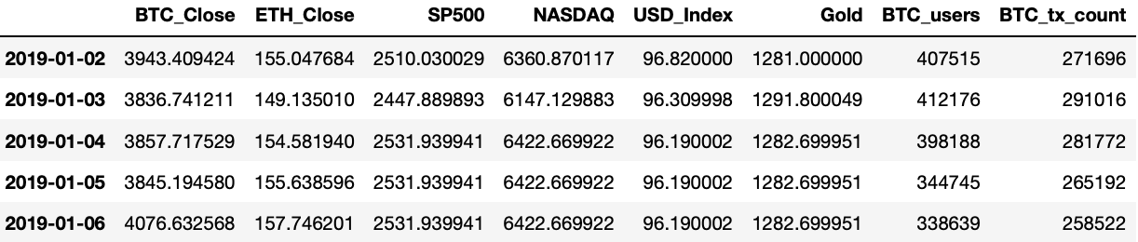
Data Pre-processing (Extracting Historical Information)
Using yfinance and Dune, the historical data of the various features were obtained
For features with price information, the relevant closing prices were obtained
For features such as Bitcoin active addresses and transaction count, no further extraction was required
Simple checks were made to ensure that there was no missing data were present.
As cryptocurrency are traded 24/7, while indexes and commodities such as S&P500 are traded only 5 days a week, the forward fill method was used to fill in the missing price information over the weekend

Slide 4
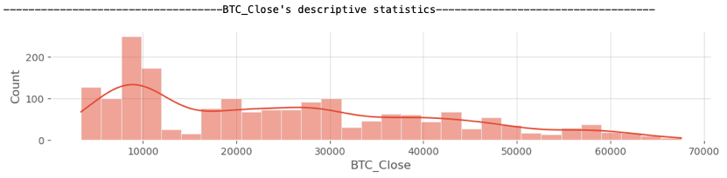
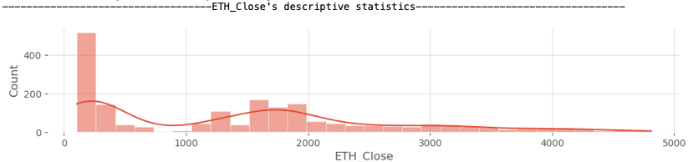
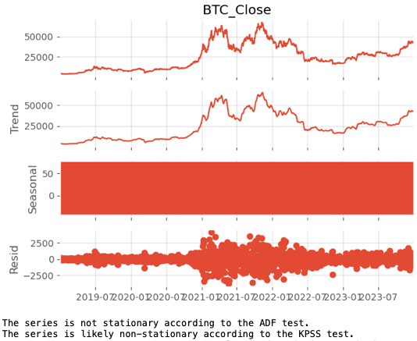
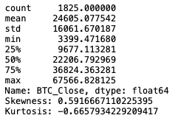
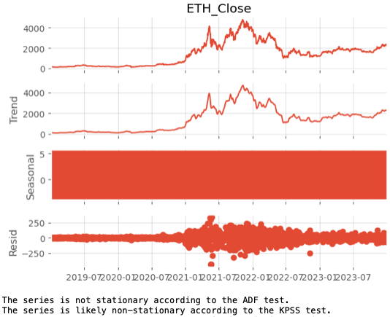
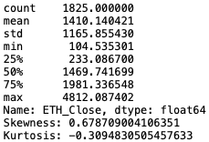
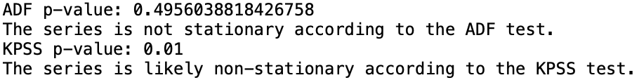
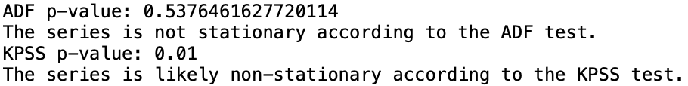
Data Pre-processing (Data Visualization)
Simple statistics was obtained for each of the relevant features
Stationarity test (both ADF and KPSS test) was performed to suggest whether further pre-processing will be required. Seasonality decomposition was also performed to visually identify whether trend and seasonality exist within the features
A simple visualization of the feature’s distribution was also obtained

Slide 5
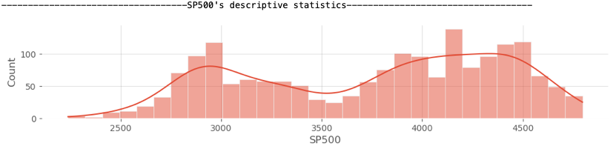
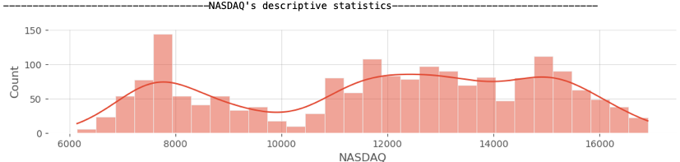
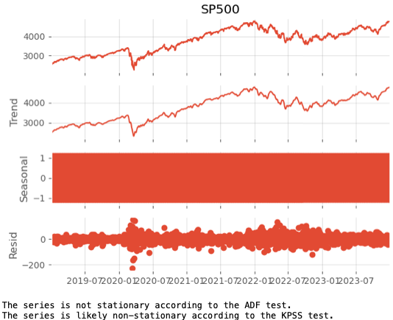
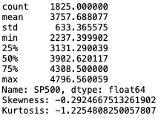
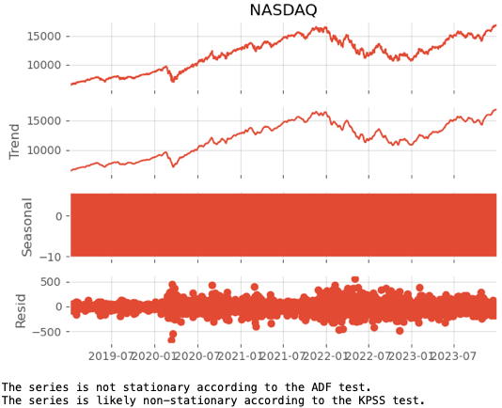
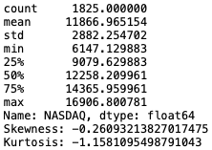
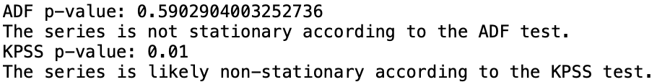
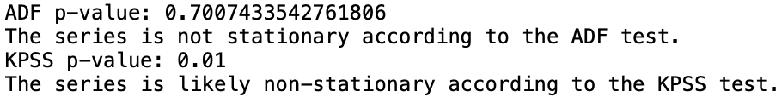
Data Pre-processing (Data Visualization)

Slide 6
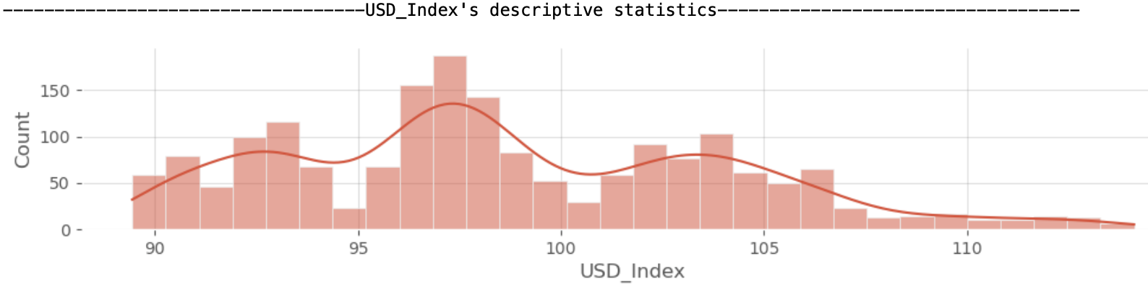
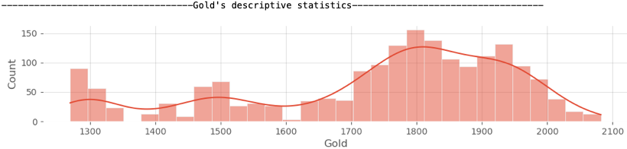
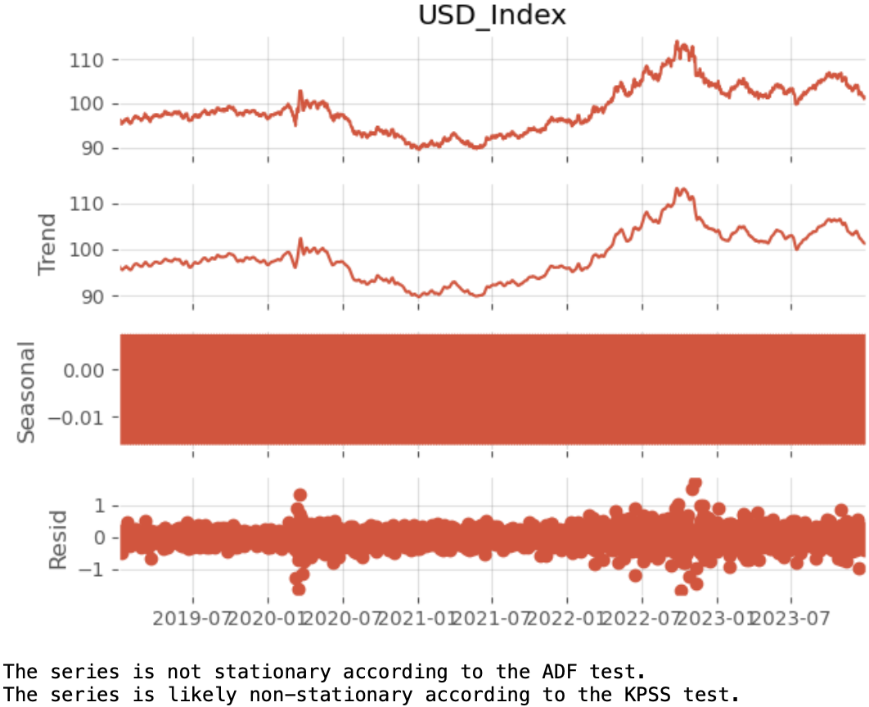
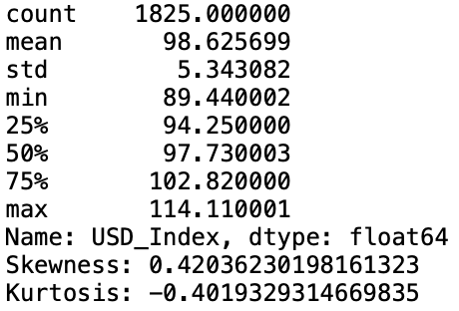
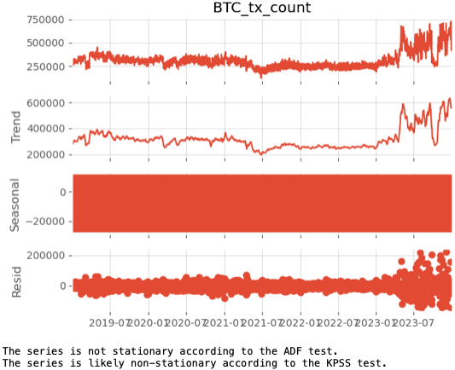
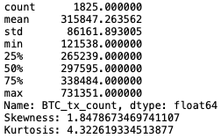
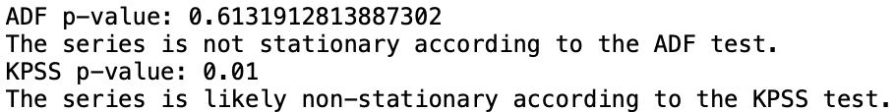
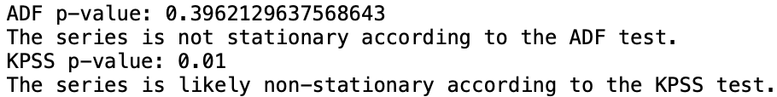
Data Pre-processing (Data Visualization)

Slide 7
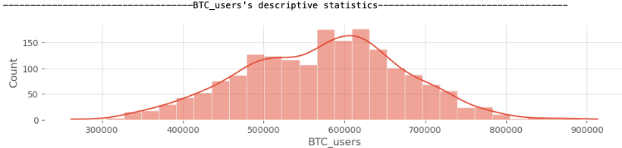
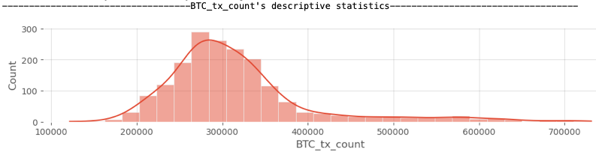
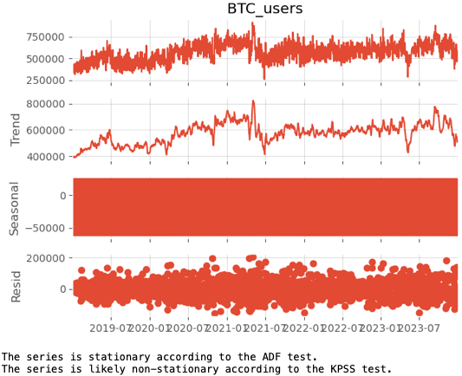
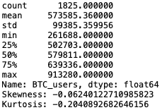
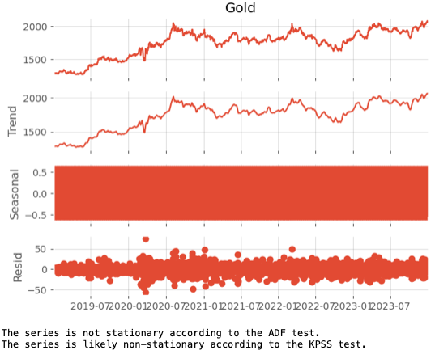
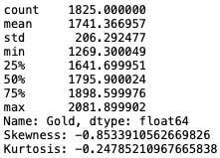
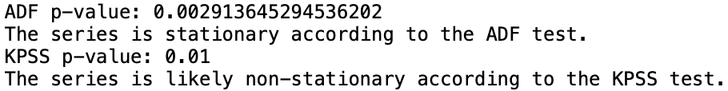
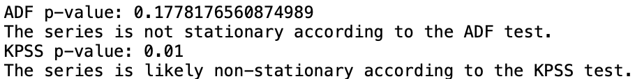
Data Pre-processing (Data Visualization)

Slide 8
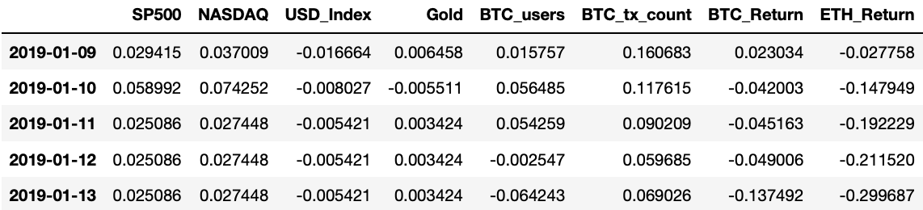
Data Pre-processing (Ensuring Data Stationarity)
To ensure stationarity, a difference of 7 days will be applied on the closing price which effectively represents the feature’s weekly returns or weekly changes
Hypothesis is that using a 7-day difference will help minimize the volatility of the data and ensure stationarity
Log transformation was applied to smoothen out the volatility within the dataset
Missing data is dropped
To ensure that the data is all processed similarly, the same data pre-processing methodology is applied on Bitcoin’s active users and transaction count

Slide 9
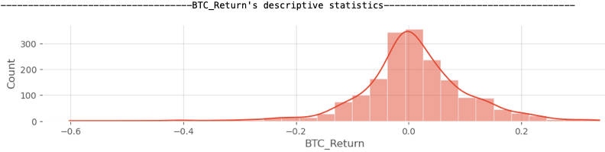
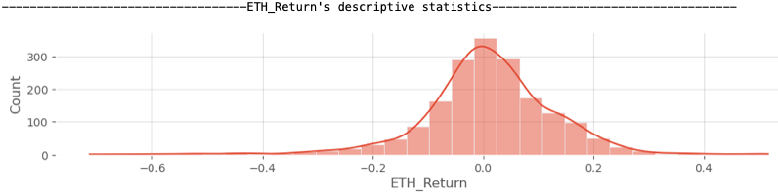
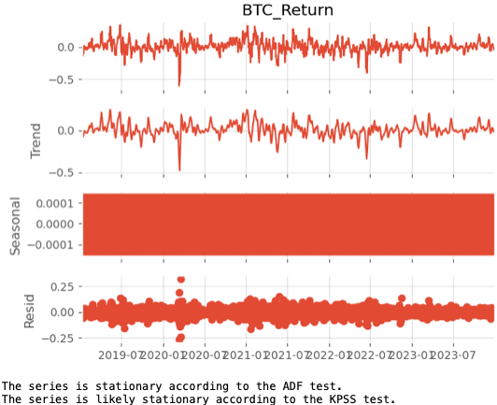
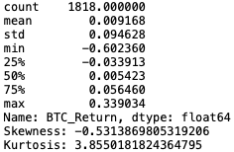
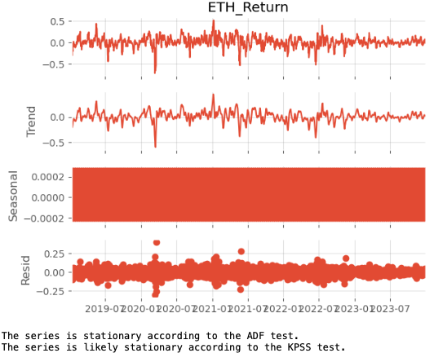
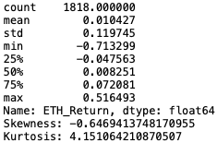
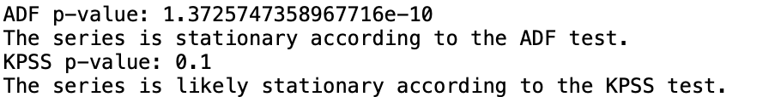
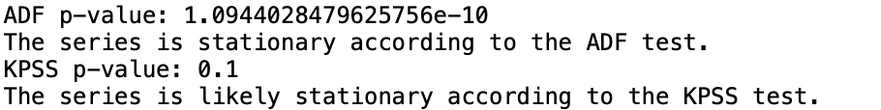
Data Pre-processing (Data Visualization - Post Data Processing)

Slide 10
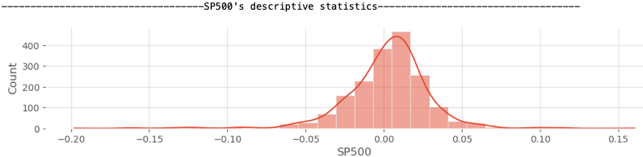
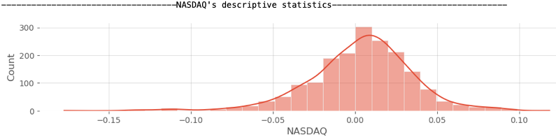
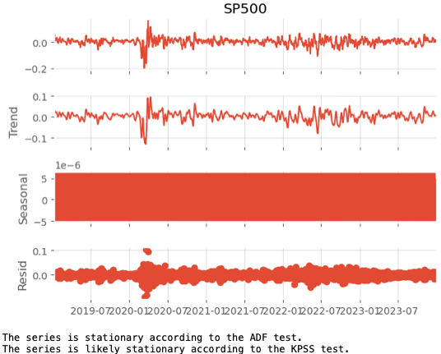
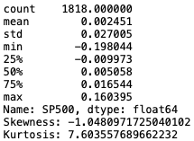
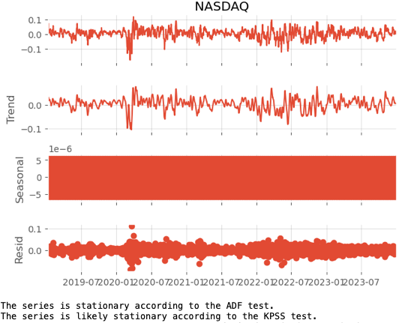
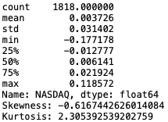
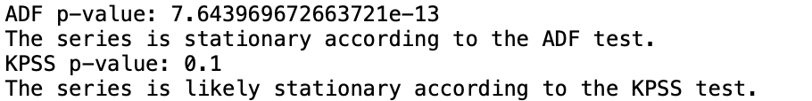
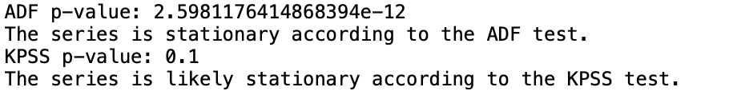
Data Pre-processing (Data Visualization - Post Data Processing)

Slide 11








Data Pre-processing (Data Visualization - Post Data Processing)

Slide 12








Data Pre-processing (Data Visualization - Post Data Processing)

Slide 13






ARIMA Model (Manual Parameter Tuning)
Modelling Bitcoin’s Returns With Its Own Time Series Information (1 Feature)
Autocorrelation Function (ACF) and Partial Autocorrelation Function (PACF)
Methodology: Uses a rolling window of 100 days to predict next day’s Bitcoin return, adapting to market changes.
ACF and PACF Analysis: Conducted for window start days: 1, 8, 15, 22, 29, 43.
Observations:
Despite the potential for variability with shifting windows, ACF and PACF show a consistent pattern across different periods.
This consistency indicates that the time series retains similar properties over time, enhancing confidence in the model.
Conclusion: Stability in ACF and PACF underscores the ARIMA model’s reliability and robustness in forecasting Bitcoin’s daily returns.

Slide 14
ARIMA Model (Manual Parameter Tuning)
Modelling Bitcoin’s Returns With Its Own Time Series Information (1 Feature)
ACF Insights:
Displays decay pattern, suggesting there may be an autoregressive component.
A pure AR model typically shows an exponential decay pattern; deviations suggest additional dynamics at play.
PACF Insights:
Sharp cut-off after the first lag indicates a likely AR(1) component.
Significant spikes at every seventh lag suggest seasonal influence, potentially needing a seasonal MA component.
Observation: Initial preprocessing showed no seasonal trends, contradicting the weak time series trends indicated by PACF, which were not detected by ADF and KPSS tests.
KPSS and ADF may omit weak time series trend due to it’s higher probability of false positives or negatives.
Non-Seasonal Component:
AR(1): Suggested due to significant correlation at the first lag.
Seasonal Component:
Seasonal MA(1) at Period 7: Indicated by significant spikes at every seventh lag in PACF.
Proposed Models for Analysis
SARIMA Model: SARIMA(1,0,0)(0,0,1)[7]
Includes non-seasonal AR(1) and seasonal MA(1) with 7-day periodicity.
Assumes stationarity with no differencing (d=0, D=0)
ARIMA Model for Comparison:
Non-seasonal ARIMA(1,0,0).
Performance comparison based on AICc values

Slide 15




ARIMA Model (Manual Parameter Tuning)
Modelling Bitcoin’s Returns With Its Own Time Series Information (1 Feature)
Hypothesis Model 1 - ARIMA(1,0,0)
Model Analysis:
ACF Observations: Generally, the residuals exhibit minimal autocorrelation. However, autocorrelation exceeds the confidence threshold at lags 7 and 32, which indicates significant autocorrelation at this lag.
Ljung-Box Test
Lag 1: Statistic = 0.272, p-value = 0.602. This indicates that the residuals at this lag do not exhibit significant autocorrelation.
Lag 7: Statistic = 22.606, p-value = 0.002. This shows a significant autocorrelation at lag 7, suggesting that the model might be missing some seasonal or cyclical components present in the data.
Lag 14: Statistic = 28.944, p-value = 0.011. The presence of autocorrelation at this and multiple intervals beyond the immediate term further indicates potential model inadequacies or unmodeled components in the series.
Achieved an average AIC of -330.92.
Conclusion
Significant autocorrelation at lags 7 and 14 suggests that the model may not be adequately capturing all data patterns. Reevaluation of model parameters, including possible adjustments for seasonal differencing or adding lags, is recommended to enhance model robustness and predictive accuracy.
Overall the model obtained a R² of 0.724, RMSE of 0.0503 and MAE of 0.034

Slide 16




ARIMA Model (Manual Parameter Tuning)
Modelling Bitcoin’s Returns With Its Own Time Series Information (1 Feature)
Hypothesis Model 2 - SARIMA(1,0,0)(0,0,1)(7)
Model Analysis:
ACF Observations: Residual exhibit minimal autocorrelation. All the lag are within the confidence threshold.
Ljung-Box Test
Lag 1: Statistic = 0.21, p-value = 0.649, indicating that the residuals at this lag do not show significant autocorrelation, confirming the model effectively captures the autocorrelation at this point.
Lag 7: Statistic = 2.19, p-value = 0.949, suggesting no significant autocorrelation, which indicates that any seasonal or cyclical components present might not be influencing the model at this lag.
Lag 14: Statistic = 8.07, p-value = 0.886, further supporting the absence of significant autocorrelation at intervals beyond the immediate term.
Achieved an average AIC of -375.75 for the SARIMA model, which is lower than the AIC of -330.92 for the ARIMA model, indicating a more efficient model fit with the SARIMA configuration.
Conclusion
The residual tests for SARIMA(1,0,0)(0,0,1)[7] model suggest robust performance with no significant autocorrelation detected in the noise, indicating effective model specification.
Despite some parameters not being statistically significant, the overall model performance justified the further exploration of this model.
The lower AIC compared to the simpler ARIMA model demonstrates improved fit and efficiency in capturing the data's underlying patterns, validating the SARIMA model as a superior choice for this dataset.
Overall the model obtained a R² of 0.848, RMSE of 0.0373 and MAE of 0.025, which suggest better out-of-sample performance than ARIMA(1,0,0) model

Slide 17


ARIMA Model (Auto-ARIMA)
Modelling Bitcoin’s Returns With Its Own Time Series Information (1 Feature)
As an improvement to the SARIMA model where a fixed “p” and “q” is used on the entire rolling window period, the auto-ARIMA model automatically selects the parameters that minimises the model’s AIC
This will hypotechnically ensure a better model as “p” and “q” are dynamically adjusted to capture changing patterns within different time period
Given the use of a rolling window approach, a detailed analysis of individual summary statistics as shown may be less relevant, as the model re-optimizes them in each window. However, on average the auto-ARIMA model achieved a mean AIC of -333.11. Comparing this to the SARIMA and ARIMA (manual approach) model, it suggest that auto-ARIMA model is a less competent model which might be due to the existence of the underlying seasonality trend as mentioned previously.
Overall the model obtained a R² of 0.708, RMSE of 0.052 and MAE of 0.03

Slide 18



VAR Model
Modelling Bitcoin’s Returns With Its Own and Ethereum's Time Series Information (2 Features)
Ethereum chosen as the 2nd variable to run the VAR model due to its proximity to Bitcoin
Utilized model.select_order().bic to avoid risk of overfitting given BIC penalizes model complexity more heavily than AIC
Low coeff and high p-value indicates L1.ETH_Return does not have substantial impact on Bitcoin return - predominantly still influenced by own past return
High +ve residual correlation suggests there are external influences affecting both variables in similar ways, not captured by this VAR model
Overall model obtained R² of 0.710, RMSE of 0.051 and MAE of 0.03 which indicates a reasonably good fit and predictive power. RMSE > MAE may indicate model’s struggle in capturing Bitcoin’s high return volatility

Slide 19





VECM Model
Modelling Bitcoin’s Returns With Its Own and Ethereum's Time Series Information (2 Features)
Run Engle-Granger cointegration test
High p-values indicates both L1.BTC_Return and L1.ETH_Return do not have strong influence on current Bitcoin return - nature of VECM that accounts for deviations from equilibrium could diminish significance of own short-term lag
Overall model obtained R² of 0.693, RMSE of 0.053 and MAE of 0.03 which indicates a slightly worse fit and predictive quality than VAR. Similarly RMSE > MAE indicates model’s struggle in capturing high return volatility

Slide 20



ARIMAX
Modelling Bitcoin’s Returns With Exogenous Features (Multiple Features)
Dependent Variable:
BTC_Return: The main focus of the ARIMAX model to forecast Bitcoin returns.
Exogenous Variables:
S&P 500 (SP500): To capture the influence of the US stock market.
NASDAQ Composite Index (NASDAQ): Reflects technology sector impacts.
US Dollar Index (USD_Index): Incorporates the effect of USD fluctuations.
Gold Price (Gold): Represents a safe haven that might influence BTC.
Bitcoin Users (BTC_users): Accounts for the growth in Bitcoin user base.
Bitcoin Transaction Count (BTC_tx_count): Measures the volume of transactions on the Bitcoin network.
Ethereum Return (ETH_Return): To consider the impact from the performance of another major cryptocurrency.
ACF Observations: Residuals exhibit minimal autocorrelation, confirming model effectiveness with all lags maintaining within the confidence threshold.
AIC Comparison: Achieved an AIC of -378.9, the lowest among all tested ARIMA models, indicating superior model fit and efficiency.
AIC comparison
Ljung-Box Test
Lag 1: Statistic = 0.046, p-value = 0.828
Lag 7: Statistic = 7.63, p-value = 0.366
Lag 14: Statistic = 11.3, p-value = 0.661
All values are above 5%, which indicates no significant autocorrelation, confirming good noise reduction and model accuracy.
Conclusion
Overall the model obtained a R² of 0.946, RMSE of 0.0224 and MAE of 0.0249, which suggest better out-of-sample performance than ARIMA models with 1 variable.
The ARIMAX model outperforms the basic ARIMA model in predicting BTC returns, evidenced by its lower AIC and better out-of-sample performance metrics (R², RMSE, MAE).
ARIMA(1,0,0) | SARIMA(1,0,0)(0,0,1)[7] | AutoARIMA
-330.92 | -375.75 | -333.24
The SARIMA(1,0,0)(0,0,1)[7] model outperforms other models with the lowest AIC value, indicating it is the most robust option available.
AutoARIMA is computationally heavy; therefore, the SARIMA(1,0,0)(0,0,1)[7] is chosen for its balance of performance and efficiency.
This model will be used as the basis for developing the ARIMAX model, leveraging its robustness in forecasting accuracy.

Slide 21


Multiple Variable OLS Regression (80/20 pareto)
Modelling Bitcoin’s Returns With Exogenous Features (Multiple Features)
80 20 train test split
Low Durbin-Watson (0.27) indicates strong positive autocorrelation in residuals ; the OLS estimates are no longer the most efficient. May have biased coefficient estimates
Significant Jarque-Bera test (p < 1.26e-24) shows non-normal residuals
High kurtosis (4.326) indicates heavy tails in the residual distribution
Overall model obtained R² of 0.687 and RMSE of 0.038 which indicates a reasonably good fit but MAE of 0.0778 indicates model’s struggle in capturing Bitcoin’s high return volatility
The identical AIC (-4242.8449) across models suggests similar model complexity-to-fit tradeoffs

Slide 22



Multiple Variable OLS Regression (expanding window with validation gap)
Modelling Bitcoin’s Returns With Exogenous Features (Multiple Features)
Rolling Window
Out of Sample
In Sample
Overall model obtained R² of 0.6467 and RMSE of 0.057 which indicates a reasonably good fit but MAE of 0.0416 indicates model’s struggle in capturing Bitcoin’s high return volatility
Similar results across Ridge and Lasso

Slide 23
Overall conclusion
Objective: To identify the best model that will be effective in predicting Bitcoin returns
Findings: Comparing the various metrics across the various models, ARIMAX model yields the best result in predicting Bitcoin’s return
Overall conclusion: ARIMAX yields the best model in predicting Bitcoin returns, with the highest R² and lowest RSME, MAE and AIC metric.
Intuition: ARIMAX includes exogenous variables, enabling the model to capture broader effects of market conditions. This suggests that macroeconomic factors do impact Bitcoin’s overall returns. The model is further enhanced by SARIMA, which identifies an underlying weak seasonal pattern, leading to improved results.
Improvements for future development: Considering that (1) features such as Bitcoin, Ethereum or index returns are negatively skewed with heavy left tails, and (2) that the nature of Bitcoin returns are volatile, a combination model could be applied. For instance, ARIMAX + GARCH model could be considered to minimise the data’s overall negative skewness and volatility. Other models to consider is LSTM and some double machine learning.
Train/Test | Dynamic Rolling Window |  |  |  |  |  |  | 80/20
Metrics | ARIMA | SARIMA | Auto-ARIMA | VAR | VECM | ARIMAX | Multi OLS | Multi OLS
R² | 0.724 | 0.848 | 0.708 | 0.710 | 0.693 | 0.946 | 0.647 | 0.689
RMSE | 0.0503 | 0.0373 | 0.052 | 0.051 | 0.053 | 0.0224 | 0.057 | 0.1146
MAE | 0.034 | 0.025 | 0.03 | 0.03 | 0.03 | 0.025 | 0.0416 | 0.0778
Mean AIC | -330.92 | -375.748 | -333.15 | -14.5 |  | -378.9

Slide 24
Thank You
Q&A

